Slide 1
Practical IoT Hacking: Introduction to Multi-Band Hacking with the CatSniffer
Eduardo Wero (@foreverwero) / Paulino Calderon (@calderpwn)

Slide 2

Workshop resources:
https://bit.ly/bhasia24-catsniffer

Slide 3
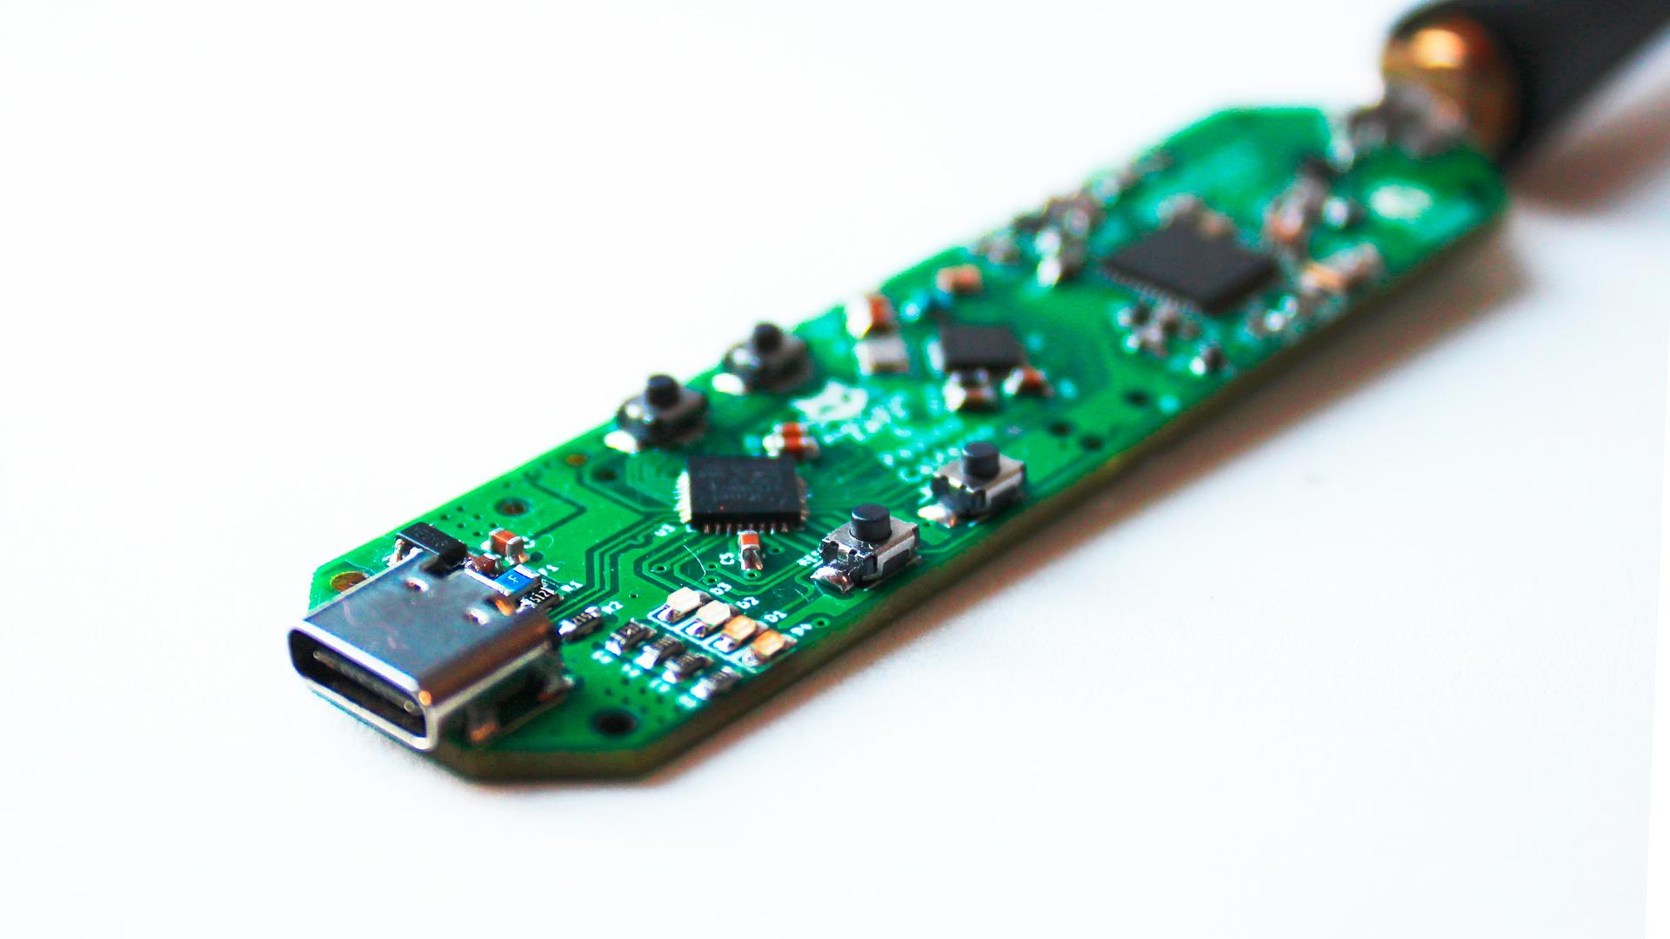
Catsniffer
CatSniffer (😼) is an innovative, multi-protocol, multi-band open source circuit board made for sniffing, communicating, and attacking IoT (Internet of Things) devices for security researchers, developers, and enthusiasts.

Slide 4
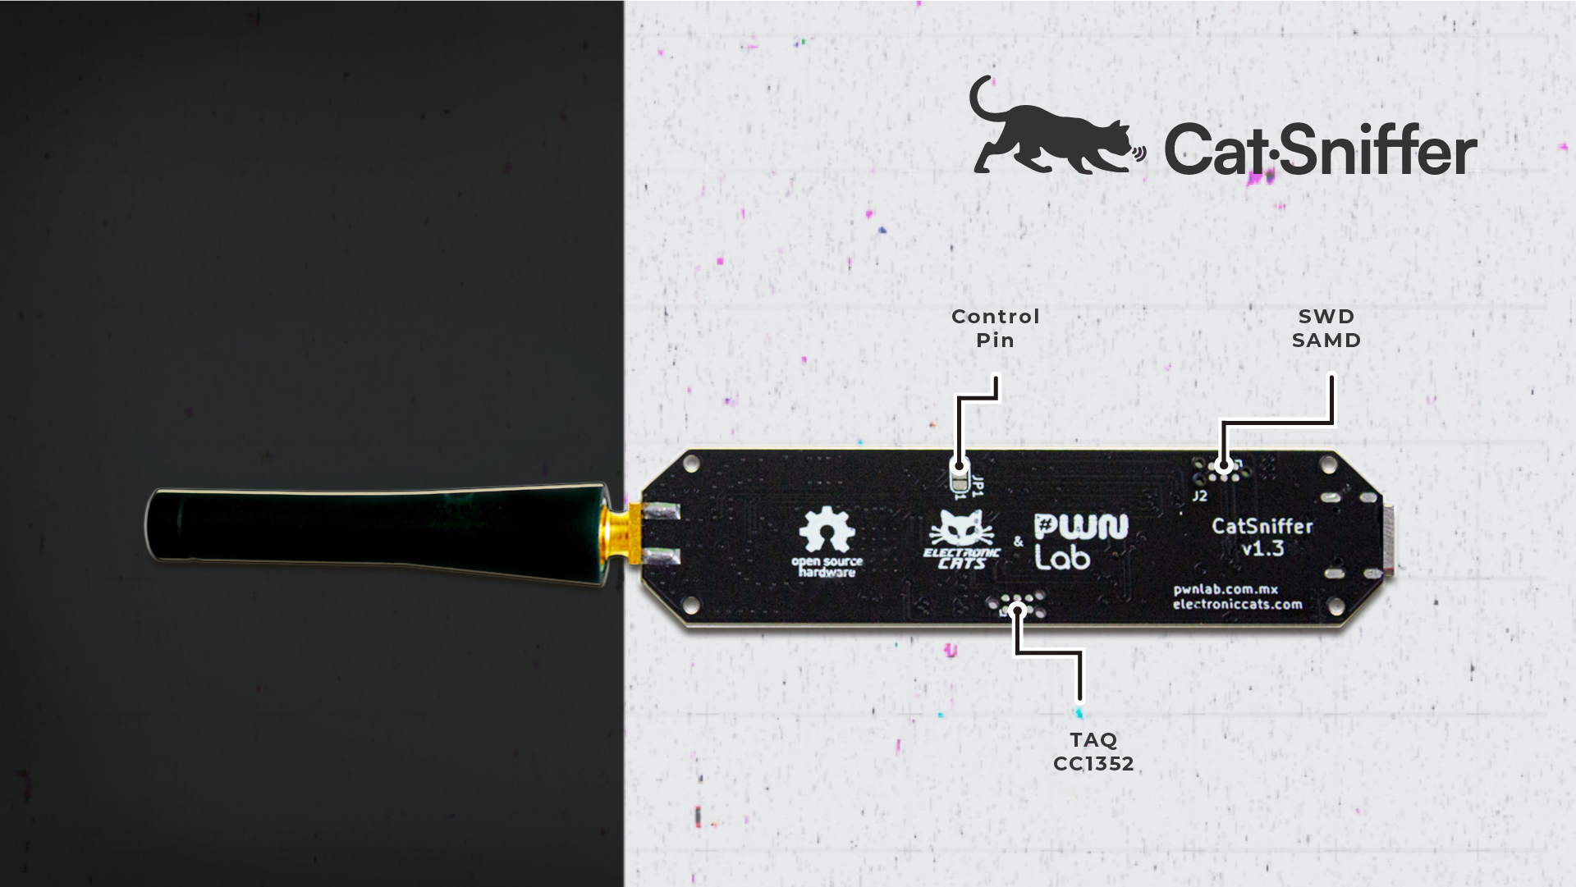
Software
It's highly versatile, compatible with a wide array of software, including:
Packet Sniffers (*)
Security auditing tools
Custom firmware developed by ElectronicCats/PWNLab
(*) It works in Windows with the latest Wireshark!

Slide 5
Protocols
1.x/2.x
3.x
Thread
Zigbee
Bluetooth 5 Low Energy (BLE)
IEEE 802.15.4g
6LoWPAN (IPv6 over Low power Wireless Personal Area Networks)
Sub 1Ghz and patented systems
LoRa/LoRaWAN
Antenna support: 868/915 MHz up to 14 dBm, 2.4 GHz up to 20 dBm
RP2040 microcontroller
+Wi-SUN
+Amazon Sidewalk
+mioty®
+Matter
+Automatic tools for programming
+Internal JTAG connection to avoid bricking your device
Antena support: 433 MHz up to 13 dBm, 2.4 GHz up to 10 dBm

Slide 6
Component Diagram (v3.x)
SX1262
SPI
RF Switch
USB
RP2040
CC1352P7
Serial
JTAG
GPIOs

Slide 7
Arsenal Lab Prerequisites
Python3 (pyserial, intel-hex and other modules might be needed but should be installed in the computer already)
BH-AS24-Catsniffer-Booklet:
https://bit.ly/bhasia24-catsniffer
Tools from https://github.com/ElectronicCats/CatSniffer-Tools

Slide 8
Practical Examples
Feel free to start now at your own pace.
Remember you have the booklet with a step-by-step guide!

Slide 9
Hands on Lab #1:
Sniffing BLE packets

Slide 10
Learning objectives
Flash firmware for sniffing Bluetooth Low Energy connections.
Learn to analyze BLE traffic.
Study the packet structure of different types of BLE packets.

Slide 11
Hands-on Lab #2: Sending BLE Packets

Slide 12
Learning objectives
Flash firmware for crafting Bluetooth Low Energy packets
Spoof personal trackers by crafting a custom BLE packet

Slide 13
Hands-on Lab #3: Sniffing unencrypted Zigbee packets

Slide 14
Learning objectives
Learn to analyze Zigbee traffic
Study the packet structure of plain text Zigbee packets

Slide 15
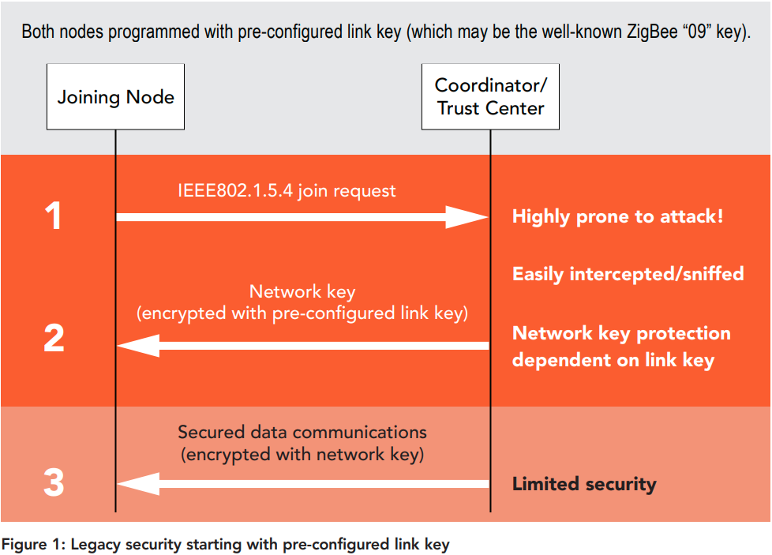
Notes:
Zigbee has been known for several years for its simplicity and effectiveness, but this same simplicity will let us capture the network key if the legacy security is being used.

Slide 16
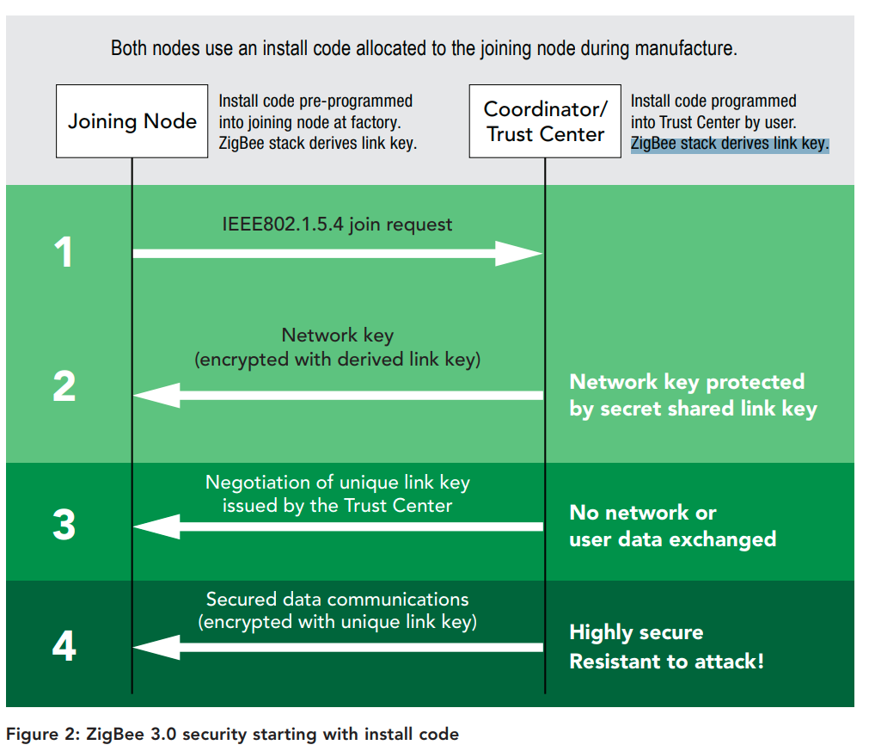
Notes:
To fix this Zigbee 3.0 has come with a pre-provisioning keys for each

Slide 17
Hands-on Lab #4: Sniffing Distributed ZigBee Networks

Slide 18
Learning objectives
Learn about how Zigbee distributed networks work
Learn how to grab Zigbee keys over the air to decrypt data packets
Learn ZigBee Device Profiles works

